Slide 1
A PRESENTATION ON FLAME PROPAGATION & FACTORS AFFECTING IT
PRESENTED BY- PRESENTED TO-
PRABIN PRADHANANGA DR. AJAY K. JHA
2070/BME/625

Slide 2
Flame Propagation in SI Engine
The combustion process in the spark-ignition engine takes place in a turbulent flow field. This flow field is produced by the high shear flows set up during the intake process and modified during compression.
After the intake stroke the fuel-air mixture is compressed and then ignited by a spark plug just before the piston reaches top center
Typical flame propagation velocity range:
15 m/s (at 1000 rpm) to 70 m/s (at 6000 rpm).
When ignition occurs, the nucleus of the flame spreads with the whirling or rotating vortices.
The speed of the flame propagation is roughly proportional to the velocity at the periphery of the vortices.

Slide 3
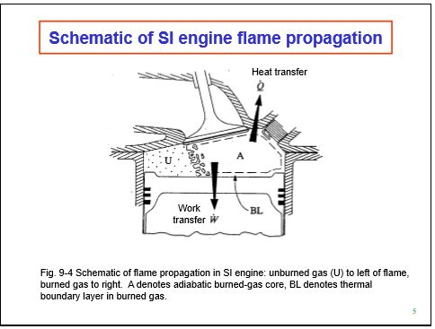

Slide 4
Ignition and Flame Development Process
Spark discharge creates a high temperature plasma kernel which expands rapidly (1mm, 100 microsec).
The hot reactive gas at the outer edge of this kernel causes the adjacent fuel-air mixture to ignite, creating an outward propagating flame which is almost spherical.
As the flame grows larger, the flame surface is distorted by the turbulence of the fluid motion. A wrinkled laminar flame results.
Because of the significant surface area enhancement by the wrinkling, the locally laminar “turbulent” flame burns rapidly.

Slide 5
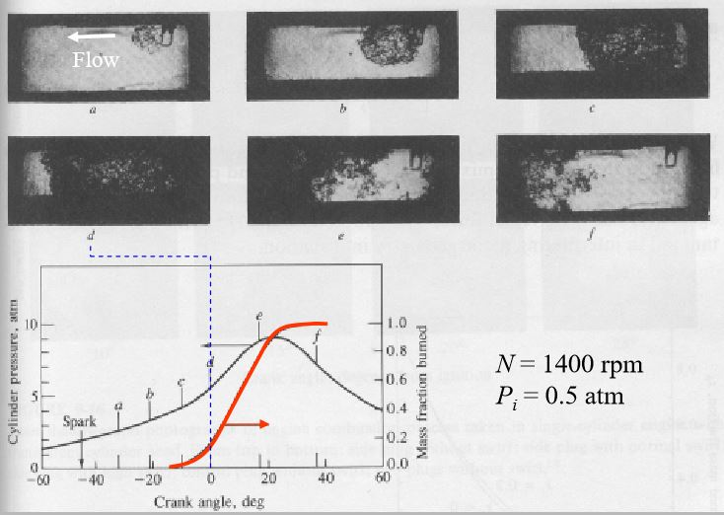
Set of photographs from one engine cycle in a square cross-section cylinder, single cylinder engine with two glass walls and corresponding pressure and mass fraction burned curves at 1400 rpm, 0.5 atm inlet pressure

Slide 6
Effect of engine variables on flame propagation
Fuel-air ratio: When the mixture is made leaner or is enriched and still more, the velocity of flame diminishes.
Compression ratio: The speed of combustion increases with increase of compression ratio. The increase in compression ratio results in increase in temperature which increases the tendency of the engine to detonate.
Intake temperature and pressure: Increase in intake temperature and pressure increases the flame speed.
Turbulence: The flame speed is very low in non-turbulent mixture. A turbulent motion of the mixture intensifies the processes of heat transfer and mixing of the burned and unburned portions in the flame front. These two factors cause the velocity of turbulent flame to increase practically in proportion to the turbulent velocity.

Slide 7
Effect of engine variables on flame propagation
Engine speed: The flame speed increases almost linearly with engine speed. The crank angle required for flame propagation, which is the main phase of combustion, will remain almost constant at all speeds.
Engine size: The number of crank degrees required for flame travel will be about the same irrespective of engine size, provided the engines are similar.
Engine load: As the load on the engine increases the cycle pressure increases and hence the flame speed increases.

Slide 8
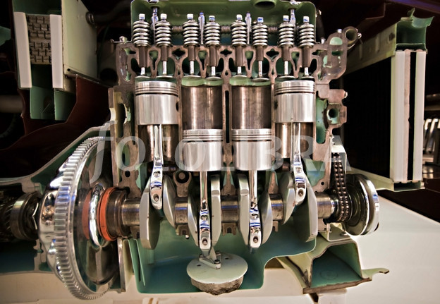
WHAT HAPPENS INSIDE AN SI ENGINE???

Slide 9
References
Internal combustion engine fundamentals, John B. Heywood
Internal combustion engines, R.K.Rajput
www.youtube.com

Slide 10
THANK YOU

